Slide 1

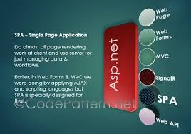
Difference Between Asp.net Web Forms and Mvc

Slide 2
Introduction
ASP.Net Web Forms are part of the ASP.NET web application framework . It has solved a lot of problems by creating a high-level abstraction over the stateless web and the stimulated stateful model for the developers. Postback and ViewState are the major concepts in the Web forms. On the other hand, ASP.Net MVC is a framework designed with separation of concerns and capability in mind. It is built on the CLR (Common Language Runtime) and based on MVC (Model-View-Controller) architecture.

Slide 3
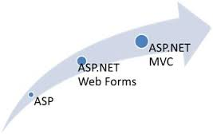
Difference
Automated testing is tedious and difficult in ASP.NET Web Forms. ASP.NET MVC wins the battle here as test driven development is quite simple in this approach.
With a lots of control libraries availability and limited knowledge of other related technologies, ASP.NET WebForms is RAD(Rapid Application Development) approach.
It’s a step back. For developers decrease in productivity.

Slide 4

Difference
Asp WebForms
Asp.web forms use page
controller patterns approach for rendering layout.In this approach every page has its own controller.
i.e code behind file that processes the request.
MVC
Asp Mvc uses a front controller approach.That approach means a common controller for all pages that processes the requests.

Slide 5
Difference between Asp webforms and asp mvc
Asp Webforms
Asp.Net Web Form follow a traditional event driven development model.
In Asp.Net Web Form, Web Forms(ASPX) i.e. views are tightly coupled to Code behind(ASPX.CS) i.e. logic.
ASP.NET WebForms model follows a Page Life cycle.
When you open a web page in the browser, it sends a request to the server and server processes this request and returns a page to the browser. This complete process is known as Life cycle of a page.
Mvc
Asp.Net MVC is a lightweight and follow MVC (Model, View, Controller) pattern based development model.
In Asp.Net MVC, Views and logic are kept separately.
No Page Life cycle like WebForms. Request cycle is simple in ASP.NET MVC model.

Slide 6
Difference
Statefulness has a lots of problem for web environment in case of excessively large viewstate. Large viewstate means increase in page size.
Asp.Net Web Form has file-based URLs means file name exist in the URLs must have its physically existence.
Asp.Net Web Form follows Web Forms Syntax
controller and view are not dependent and also no viewstate concept in ASP.NET MVC, so output is very clean.
Asp.Net MVC has route-based URLs means URLs are divided into controllers and actions and moreover it is based on controller not on physical file.
Asp.Net MVC follow customizable syntax (Razor as default)

Slide 7
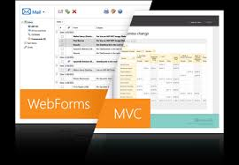
Difference
Asp.Net Web Form has Master Pages for consistent look and feels.
Asp.Net Web Form has User Controls for code re-usability.
Asp.Net Web Form is not Open Source.
In ASP.NET Web Forms, minimal knowledge of HTML, JavaScript and CSS is required.
Asp.Net MVC has Layouts for consistent look and feels.
Asp.Net MVC has Partial Views for code re-usability.
Asp.Net Web Form is an Open Source.
In MVC, detailed knowledge of HTML, JavaScript and CSS is required.

Slide 8
Conclusion
Asp.Net Web Forms:
Asp.Net Web Form follow a traditional event driven development model.
Asp.Net Web Form has server controls.
Asp.Net Web Form has state management (like as view state, session) techniques.
Asp.Net Web Form has file-based URLs means file name exist in the URLs must have its physically existence.
Asp.Net Web Form follows Web Forms Syntax
In Asp.Net Web Form, Web Forms(ASPX) i.e. views are tightly coupled to Code behind(ASPX.CS) i.e. logic.
Asp.Net Web Form has Master Pages for consistent look and feels.
Asp.Net Web Form has built-in data controls and best for rapid development with powerful data access.
Asp.Net Web Form is not Open Source.

Slide 9
Conclusion
ASP MVC
Asp.Net MVC is a lightweight and follow MVC (Model, View, Controller) pattern based development model.
Asp.Net MVC has html helpers.
Asp.Net MVC has no automatic state management techniques.
MVC has route-based URLs means URLs are divided into controllers and
actions and moreover it is based on controller not on physical file.
Asp.Net MVC follow customizable syntax (Razor as default)
In Asp.Net MVC, Views and logic are kept separately.
Asp.Net MVC has Layouts for consistent look and feels.
Asp.Net Web Form has User Controls for code re-usability.
Asp.Net MVC has Partial Views for code re-usability.

